Slide 1
GPU-Accelerated 3D Ant Colony Simulation and Visualization
Dan Andersen

Slide 2
Motivation / Background
Ant colony optimization algorithms are useful for pathfinding
Robotics, distributed networks
Each ant only needs knowledge of its immediate surroundings
This makes it great for parallelization / GPGPU
Basic setup:
Ants wander randomly from nest, laying pheromone trails
They pick up food and bring it back to the nest
Other ants follow the trail to the food

Slide 3
Demo

Slide 4
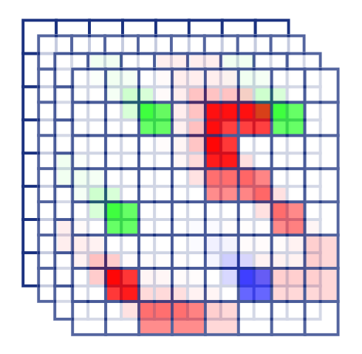
Approach – Simulation - World
3D texture (N x N x N)
Red: Nest
Green: Food Amount
Blue: Trail Strength
Alpha: Ant
Shader sets trail to max value if ant is in cell
Otherwise, fades the trail

Slide 5
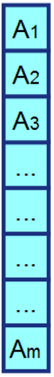
Approach – Simulation - Ant
2D texture (M x 1)
RGB: XYZ position in world
Alpha: ant state (direction, carrying food)
For each ant, the fragment shader:
Picks up / drops off food
Determines where the ant is allowed to move
Calculates score for each possible choice
Moves to best choice (sometimes moves randomly)

Slide 6
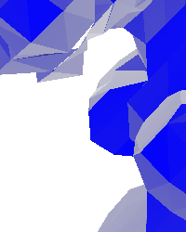
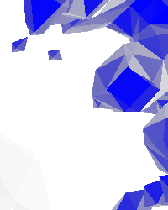
Approach - Visualization
Geometry shader
Input: a single vertex at each grid point
Output: A set of triangles for the mesh near that point
Using marching cubes algorithm (Lorensen 1987)
Evaluate value at point and 8 surrounding points
Look up in array of 256 possible configurations
Use linear interpolation to determine vertex locations

Slide 7
Demo

Slide 8
Results
Swarm behavior of ants is sensitive to variation in ant path-finding algorithm
Ants can get stuck in their own trail
This happens in the real world too (ant mills)
Runs at real-time rates up to world size of 128x128x128

Slide 9
Summary
Simulated ant-like motion using fragment shaders
Visualized simulation using marching cube algorithm in geometry shaders
UI includes customizable parameters

Slide 10
Future Work
Use of VBOs can improve visualization performance
Different trails (toward food and toward nest) can improve swarm behavior
Storing history of ant movement can prevent self-loops
Weighted random selection of possible destinations, rather than always choosing highest score

Slide 11
Questions?

